Slide 1

Technical Presentation
Optimizing Task Scheduling with Priority Queue
Under the Guidance of:
Dr. Rajesh Kumar
CSA0315- Data Structure
Date: 21/07/2026
Presented By:
S. Maruthu Pandi – 192511162

Slide 2


Introduction
Task Scheduling is the Process of assigning CPU or system resources to Tasks
Many applications require executing tasks based on their priority
Examples:
Printers
Hospitals
Food Delivery

Slide 3

Problem Statement
A Task Scheduling system must:
Accepts new tasks dynamically
Assign Priority to Tasks
Execute High-Priority to Tasks
Handle Multiple Tasks efficiently

Slide 4
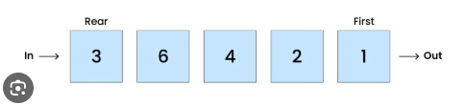
Suitable Data Structure
Queue
A priority Queue is a special Queue where each element has a priority
Elements with higher priority are processed before low priority elements
It follows (FIFO) First IN First OUT

Slide 5
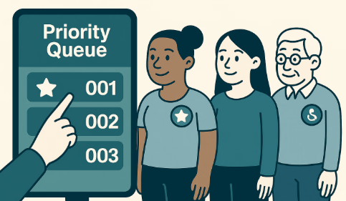
How It Works ?
Tasks Enters the system
Priority is Assigned
Queue sorts automatically
Highest Priority task is selected
Task executes
Process Repeats
Operation | Time Complexity
Insert | 0(log n)
Delete | 0(log n)
Peek | 0(1)

Slide 6
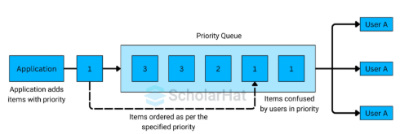
Importance of Priority Queue
Executes Important Tasks First
Improves Response Time
Efficient Resource Utilization
Supports Dynamic Scheduling
Scalability

Slide 7
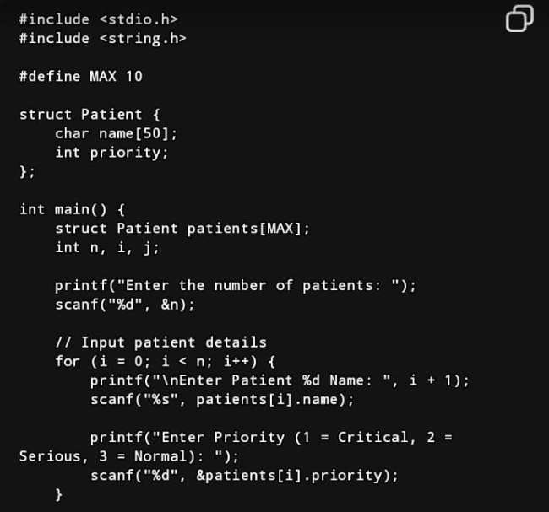
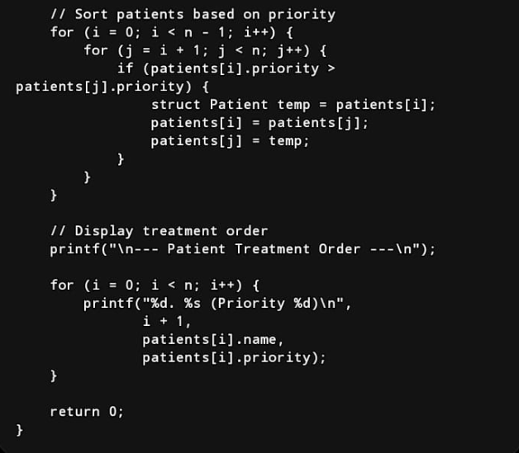

C Programming on the Priority Queue

Slide 8
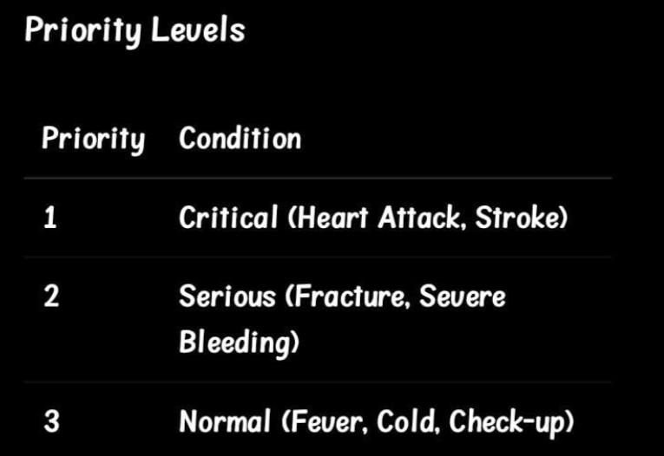
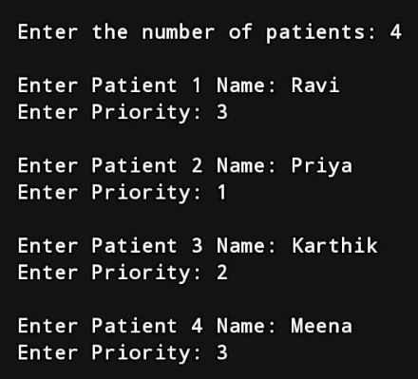
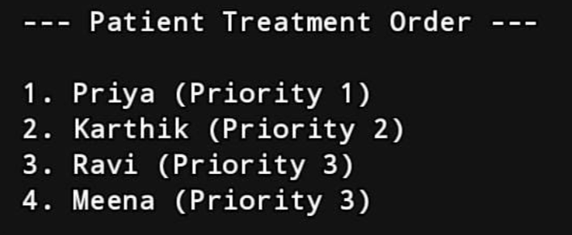
Input
Priority Level
Output

Slide 9


